Slide 1
Class XII Project Presentation
Dispensary Management
By : Pranav (03)
Abhiram (04)
Harsha Vardhan (433)

Slide 2


Technologies Used
&

Slide 3
Inbuilt Modules Used in Python
Time Module : for sleep function to keep timeout after input
OS Module : for clearing the terminal
Math Module : for performing operations related to height and weight value
Datetime Module : for managing admission and discharge dates

Slide 4
External Modules Used in Python
MySQL-connector : for establishing connection between the program and the database engine
Pretty Table : for tabular representation in the terminal

Slide 5
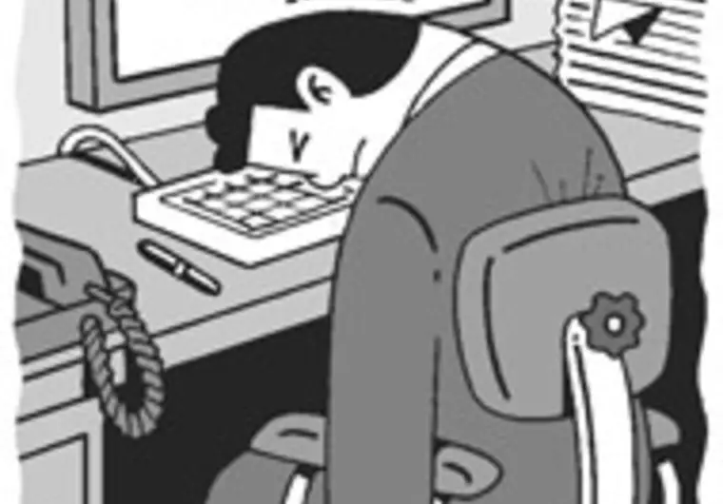
Use of the Project in Real Life
It can be tedious to manage the medicines and records of the cadets
So we help you out to manage the docs using our project

Slide 6
How to use the project
The project does not have any Graphical User Interface
Then how to use
Finally You can save some time. No need to find buttons
By just pressing Numbers

Slide 7
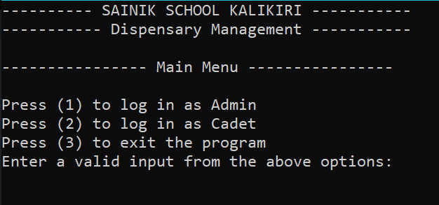
The Security
Security is Important or else ...
You must know your username and password for logging in. If you don't have yours
then you are not a valid user

Slide 8
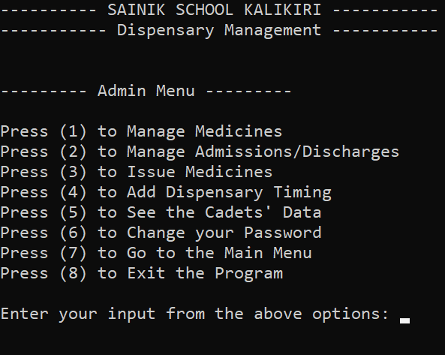
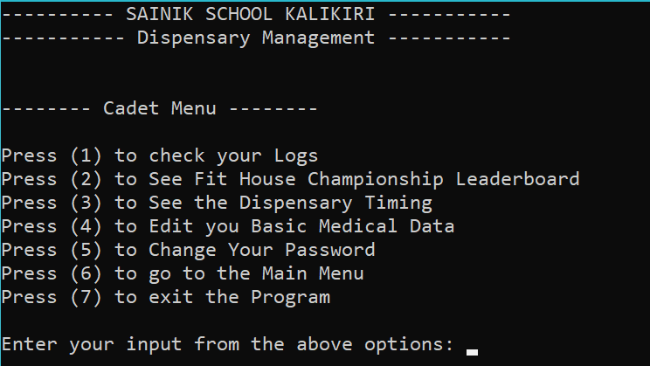
The Menus
Admin and Cadet have their separate menu. So there will be good exchange of information without security comptonization

Slide 9
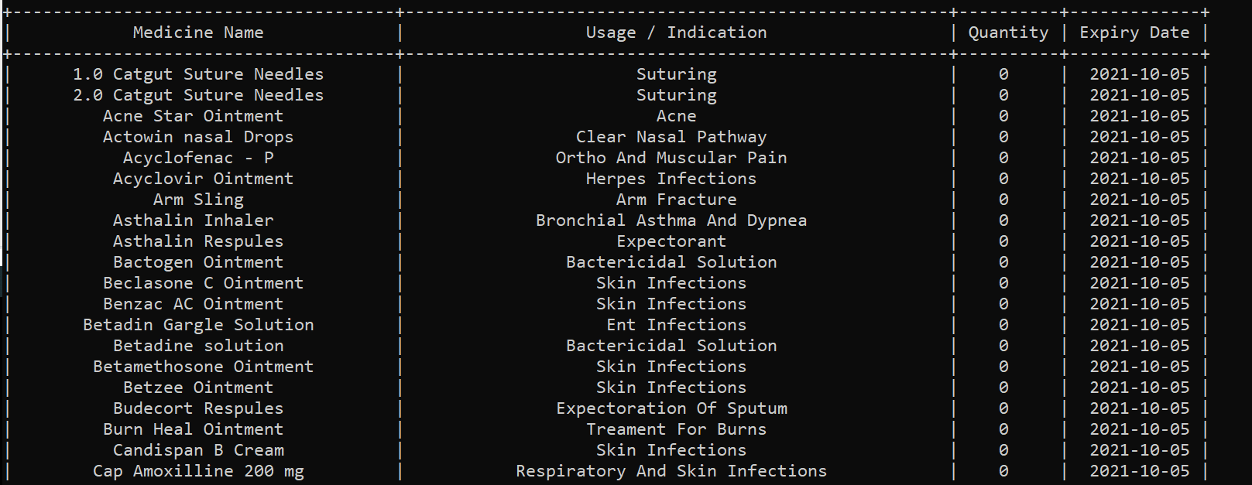
The Representation
All the data is represent in tabular form for users convenience

Slide 10
Available Features for Admin
Manage Medicines
Manage Admissions/Discharges
Issue Medicine
Add Dispensary Timing
See Cadet's Data
Change you password

Slide 11
Available Features for Cadet
To check cadet's logins
To see fit house championship leaderboard
To see the dispensary timing
To change cadet password

Slide 12
Code of the Project
The code of the project is available in a GitHub Repository at the following link

Slide 13
Thank You

